Slide 1
Applications of Machine Learning in Manufacturing
C. Shiva Sathwik Reddy (160723733047)

Slide 2
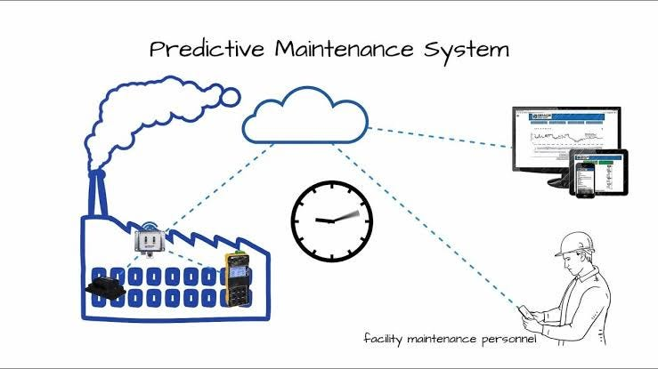
1. Predictive Maintenance
Machine Learning is used to:
  Collect data from sensors in machines
  Predict failures before they occur
  Reduce machine breakdowns and downtime

Slide 3
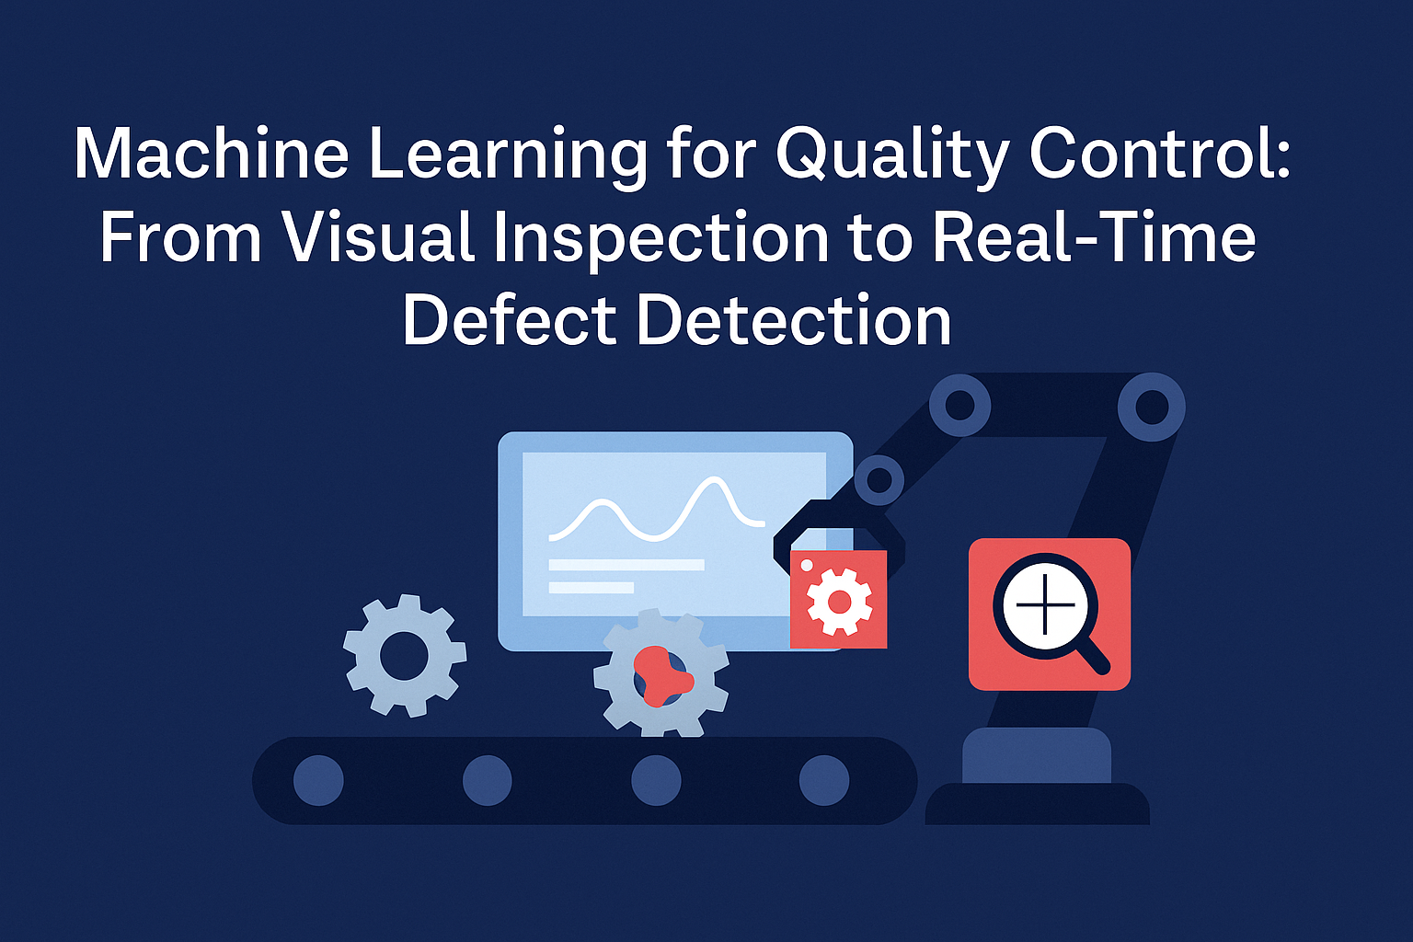
2. Quality Control and Defect Detection
In manufacturing, ML is used to:
  Detect defects in products using cameras
  Check size, shape, and surface quality
  Reduce human errors

Slide 4
3. Process Optimization
Machine Learning helps to:
  Optimize production processes
  Reduce material waste
  Improve energy efficiency

Slide 5

4. Supply Chain Management
Machine Learning is used to:
  Predict demand for products
  Manage inventory efficiently
  Reduce delays in supply
This helps in smooth production planning.

Slide 6
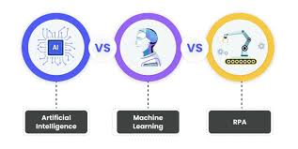
5. Robotics and Automation
Machine Learning is applied in:
  Industrial robots
  Assembly lines
  Human–robot collaboration
Robots learn tasks faster and work more safely.

